Slide 1
Movement agreement between rider and horse
Classifier sequence to show movement
establish movement of horse ((2h)SCL:V)
establish you on the horse (SCL:V”rider” on LCL:B”horse”)
establish your actions (ICL“holding reins”)
Facial expression/head movement superimposed
Notes:
B24
p.120

Slide 2
Movement Agreement between Horse and Rider
horse starts bucking up
horse rears up on hind legs
horse suddenly sits down on all four legs
horse is trotting along
Notes:
M26.1
p.121

Slide 3
Movement Agreement between Horse and Rider
horse starts bucking up
horse rears up on hind legs
horse suddenly sits down on all four legs
horse is trotting along
horse moves at a slow speed to a very fast speed
horse runs from very fast to slow
horse slows down to stop
running horse comes to a dead stop
horse moves slowly to fast, then back to slowly
running horse stumbles and falls
galloping horse steps into a hole and falls
Notes:
M26.2
p.122

Slide 4
Movement agreement between rider and horse
Classifier sequence to show movement
establish movement of horse
establish you on the horse
establish your actions
Show change in movement or speed
reestablish horse and show change in
movement or speed
reestablish rider to match the change
Facial expression/head movement superimposed
Notes:
B25
p.122

Slide 5
Basic Action Sequence: Bicycle Tricks
Establish person riding a bicycle
Describe trick person does
if necessary, identify part of bike (DCL) involved in the trick
show person changing position on bicycle (SCL:V, ICL and/or BPCL) to perform the trick
Notes:
B26
p.126

Slide 6
Basic Action Sequence: Bicycle Stunts
Describe terrain (if not flat)
Describe bicyclist holding handlebars (using (2h)ICL)
Describe trick (using SCL:3)
Notes:
B27
p.127

Slide 7
Basic Action Sequence: Two-Person Bicycle Trick
Establish the position of first person (the one steering) by using (2h)ICL, SCL:V, and/or BPCL
Establish the “other” person in relation to the first person and tell what s/he is doing by using (2h)ICL, SCL:V, and/or BPCL
Notes:
B28
p.128

Slide 8
Narrative Sequence
Tell what person was doing on/with a bicycle
Tell what happened
describe barrier/terrain
tell what person should have done (hindsight)
tell how bicycle hit barrier/terrain (impact)
reestablish rider to show how s/he fell/landed (reactions)
Notes:
B29
p.131

Slide 9
Byron’s first near miss:
Set up trucks and cars
Describe going between trucks
Show reaction to what’s happening ahead
Reestablish the positions of trucks and cars
Describe accident
Describe feeling being caught between trucks
Describe trucks and cars moving away from each other
Describe the escape
Notes:
B30
p.136

Slide 10
Movement Agreement between Driver and Car
Part A
establish rhythm between you and the car’s movements
driving along with a flat tire
driving on road with lots of pot holes
driving in heavy rain or fog
driving along rolling hills
Notes:
M27
p.139

Slide 11
Movement Agreement between Driver and Car
Part B
establish movement between you and movement of other cars, then describe what happened
waiting for no on-coming cars so I can pass
parked on side of road, cars passing by and rocking my car
at the intersection, waiting for cars to clear so I can cross the highway
driving along, another car pulls up alongside me, the driver gives me a look then drives off
another car approaches from behind flashing its lights, I move over to the right lane so the other car can pass me
another car enters the freeway so I slow down to let the car merge into the lane
Notes:
M28
p.139

Slide 12
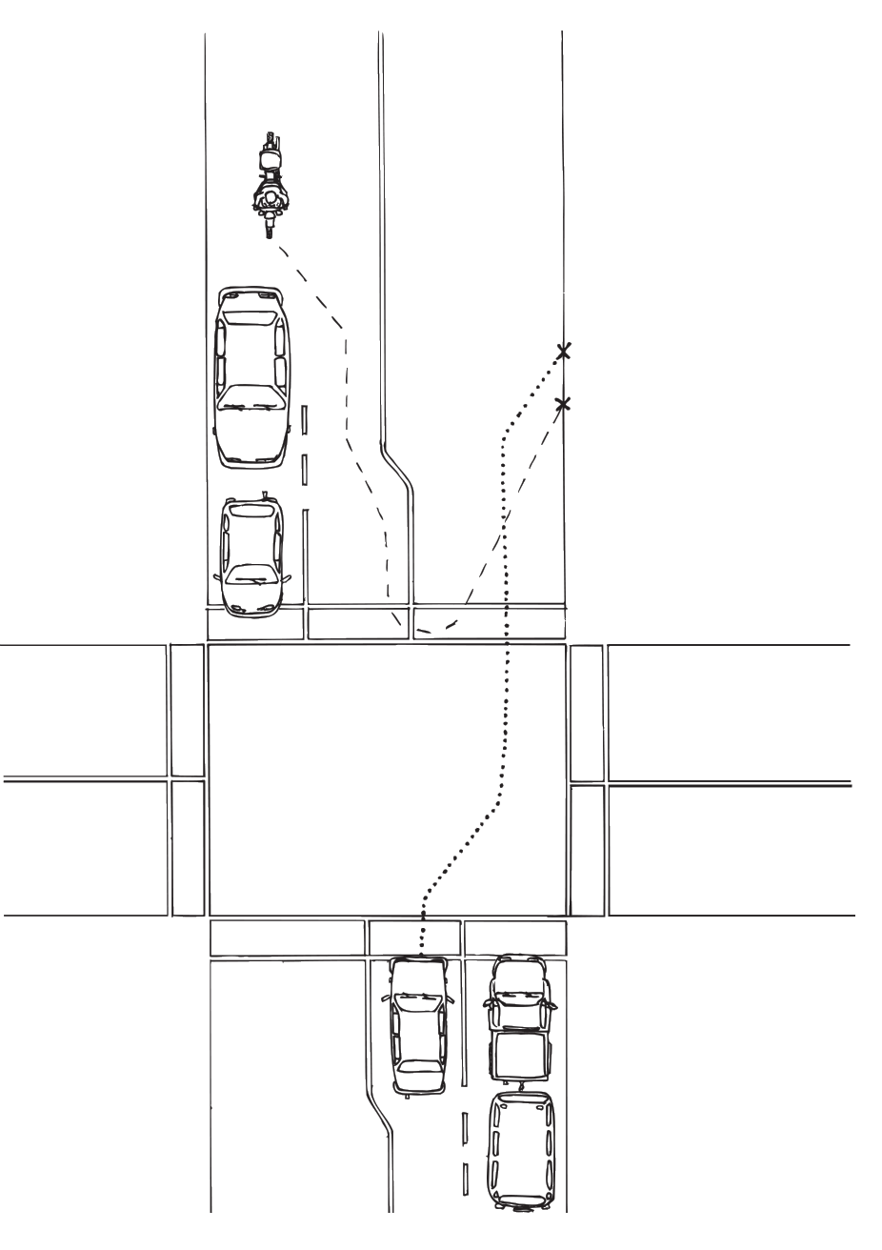
Scene of the Traffic Violation
Notes:
M29
p.141

Slide 13
Two–Car Collisions
Describe impact and damage sustained when:
A car hits another car head-on
A car rear ends car in front
A car hits another car on the side
A card backs into another car
A car sideswipes another car
Notes:
M31
p.151

Slide 14
What would lead up to that kind of collision?
How did the cars collide?
What kind of damage would the car(s) sustain?
What kind of injuries would people sustain?
Notes:
B31
p.155

